Slide 1

Agenda
Access the Wikipedia link for trillion-dollar economies
Web scrap the tables
Convert the table information to graphs
Bring out the insights using the visualization
Make predictions on the data

Slide 2
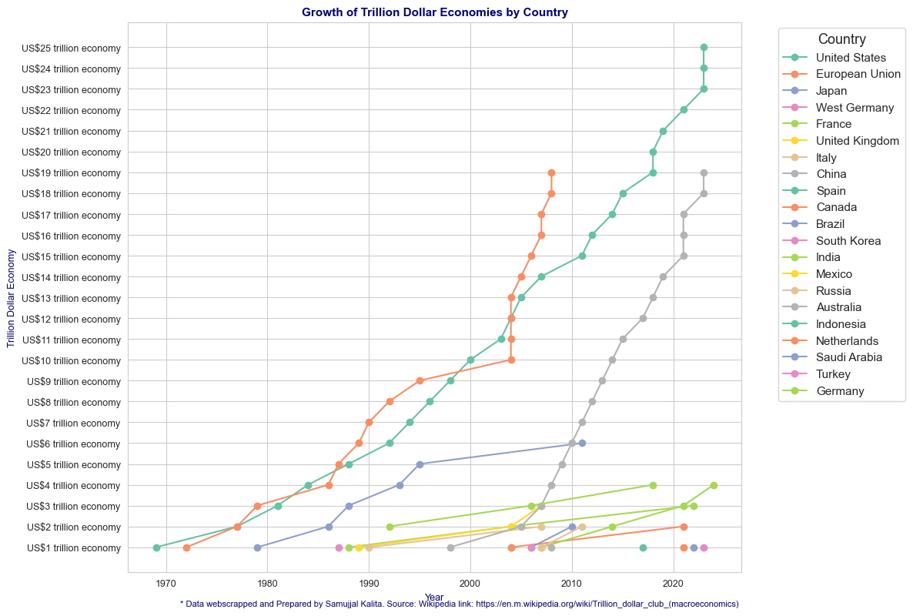
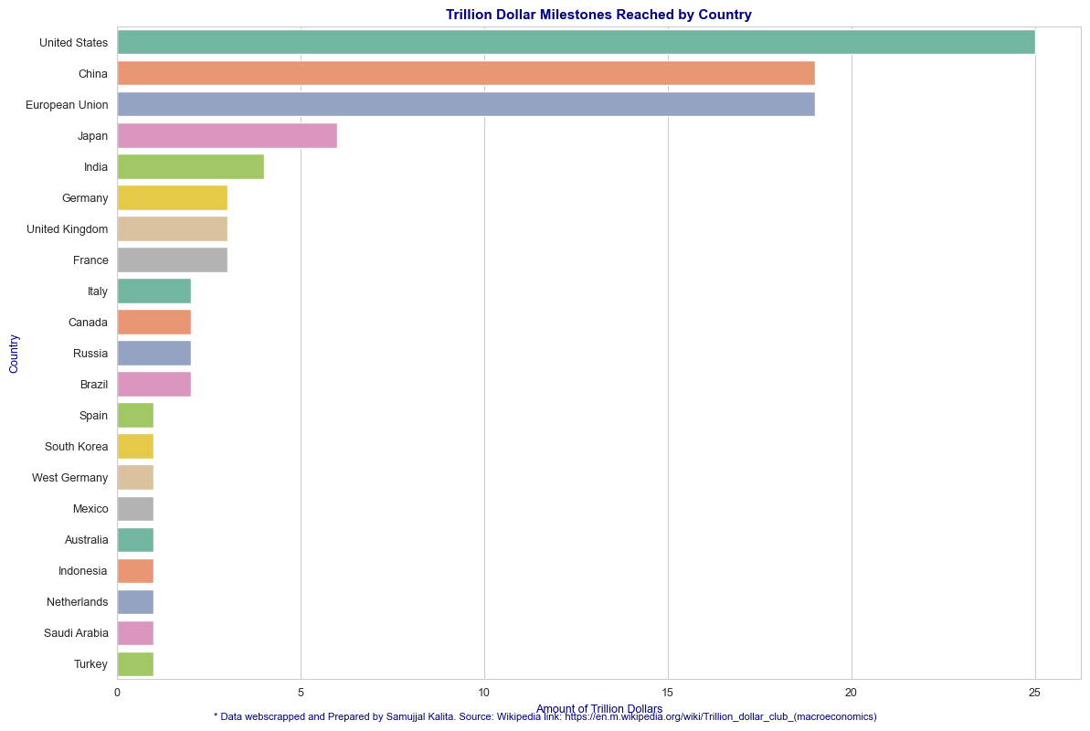
Graphs
https://en.m.wikipedia.org/wiki/Trillion_dollar_club_(macroeconomics)
Country’s trillion-dollar milestone reach YoY
Country’s Total GDP

Slide 3
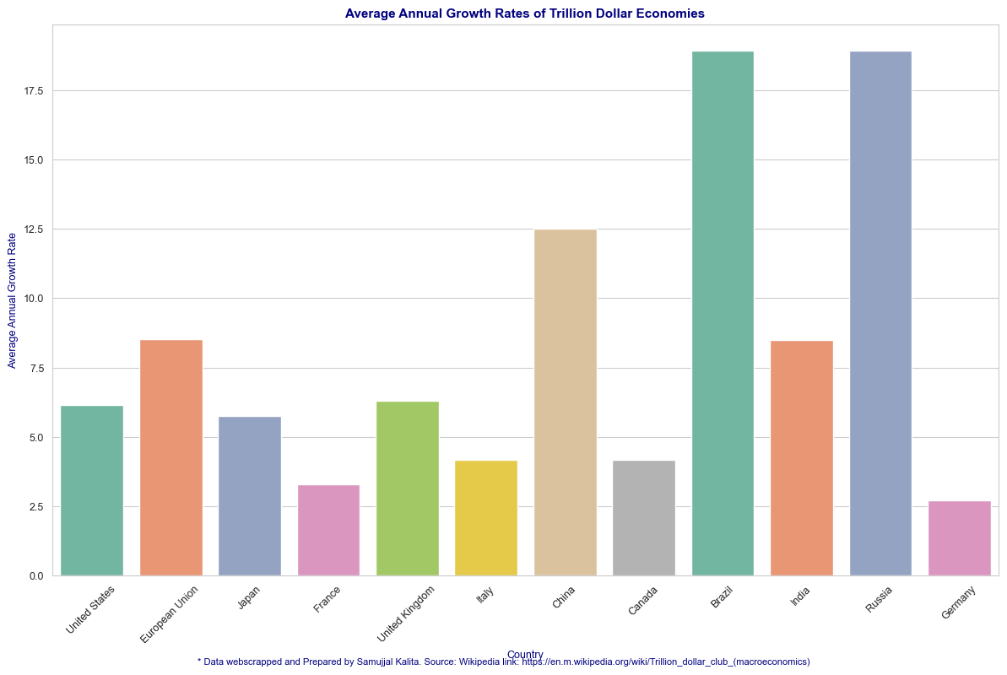
Graphs and observations
United States
The US reached a US$1 trillion economy in 1969 and reached a US$10 trillion economy by 2000.
The US economy crossed the US$20 trillion mark in 2018.
As of 2024, the US economy is valued at US$25 trillion.
China
China became a US$1 trillion economy in 1998.
It reached the US$10 trillion mark in 2014.
As of 2023, China’s economy is valued at US$19 trillion.
India
India reached the US$1 trillion mark in 2007.
It became a US$2 trillion economy in 2014.
As of 2024, India’s economy is valued at US$4 trillion.
GDP Growth rate

Slide 4
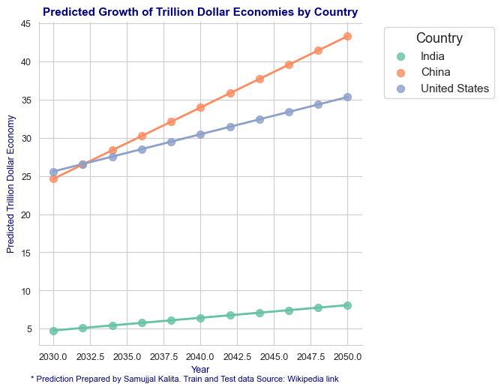
Graphs and Prediction calculation vs Machine Learning
The prediction values seems not correct , due to not considering India's actual GDP Y0Y
Although, global predictions says India will reach 30 Trillion

